Slide 1
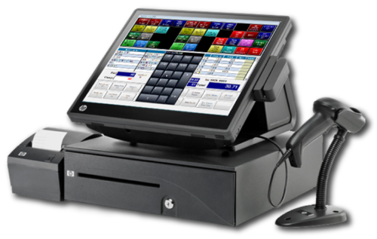
ODOO FRAMEWORK TRAINING REPORT
POS
(Point of sale)
Reporter: Phan Van Phuoc Thinh
Email: thinh.pvp@vn.vinx.asia

Slide 2
Structure:
Overview
Function of Odoo Point of Sale
Demo Point of Sale
Summary

Slide 3
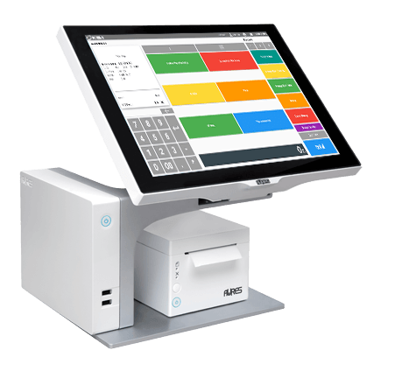
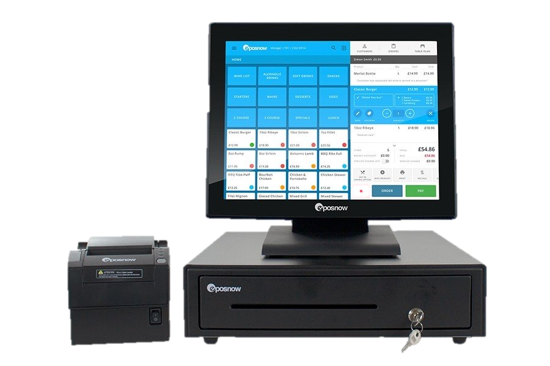
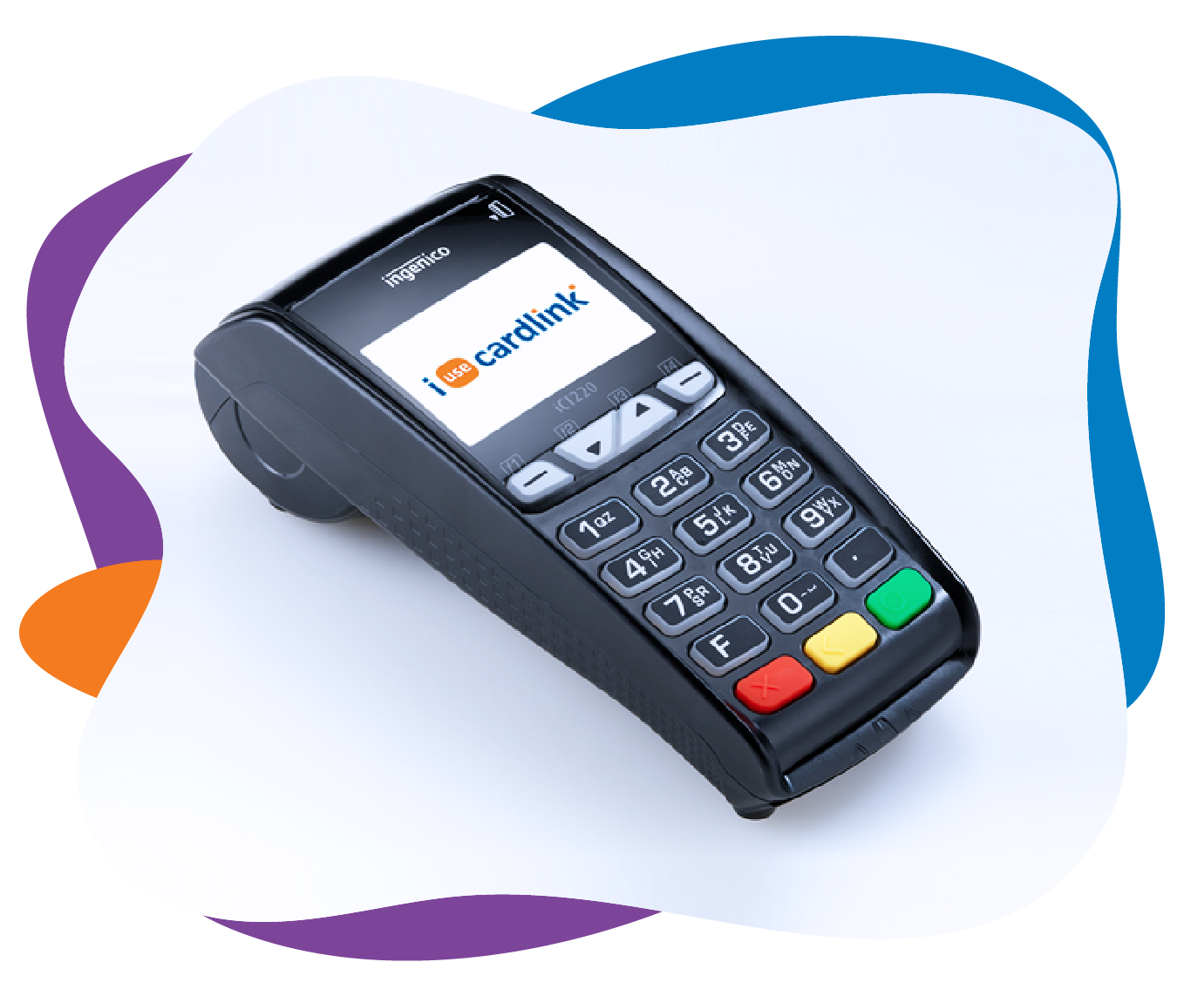
Overview
A point of sale system, or POS, is the place where your customer makes a payment for products or services at your store. Simply put, every time a customer makes a purchase at your store, they’re completing a point of sale transaction.

Slide 4
Overview
A point of sale system, or POS, is the place where your customer makes a payment for products or services at your store. Simply put, every time a customer makes a purchase at your store, they’re completing a point of sale transaction.
Odoo's online Point of Sale application is based on a simple, user friendly interface. The Point of Sale application can be used online or offline on iPads, Android tablets or laptops.
Odoo Point of Sale is fully integrated with the Inventory and Accounting applications. Any transaction in your point of sale will be automatically registered in your stock and accounting entries but also in your CRM as the customer can be identified from the app.

Slide 5
Overview
You will be able to run real time statistics and consolidations across all your shops without the hassle of integrating several external applications.

Slide 6
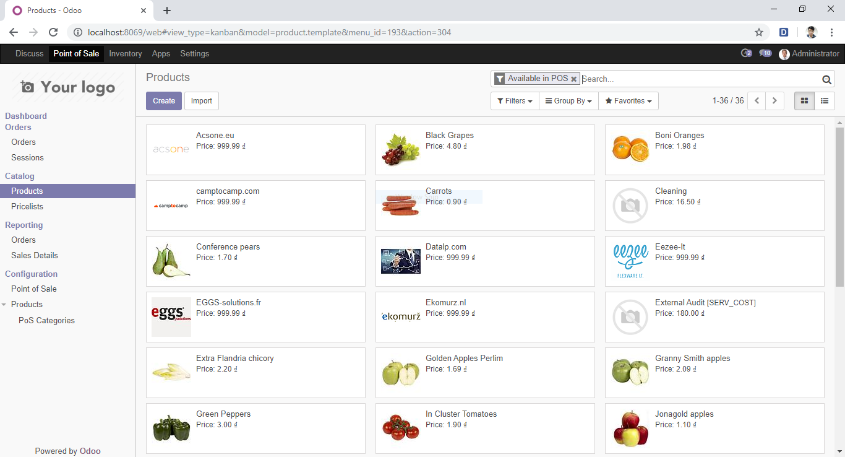

Slide 7
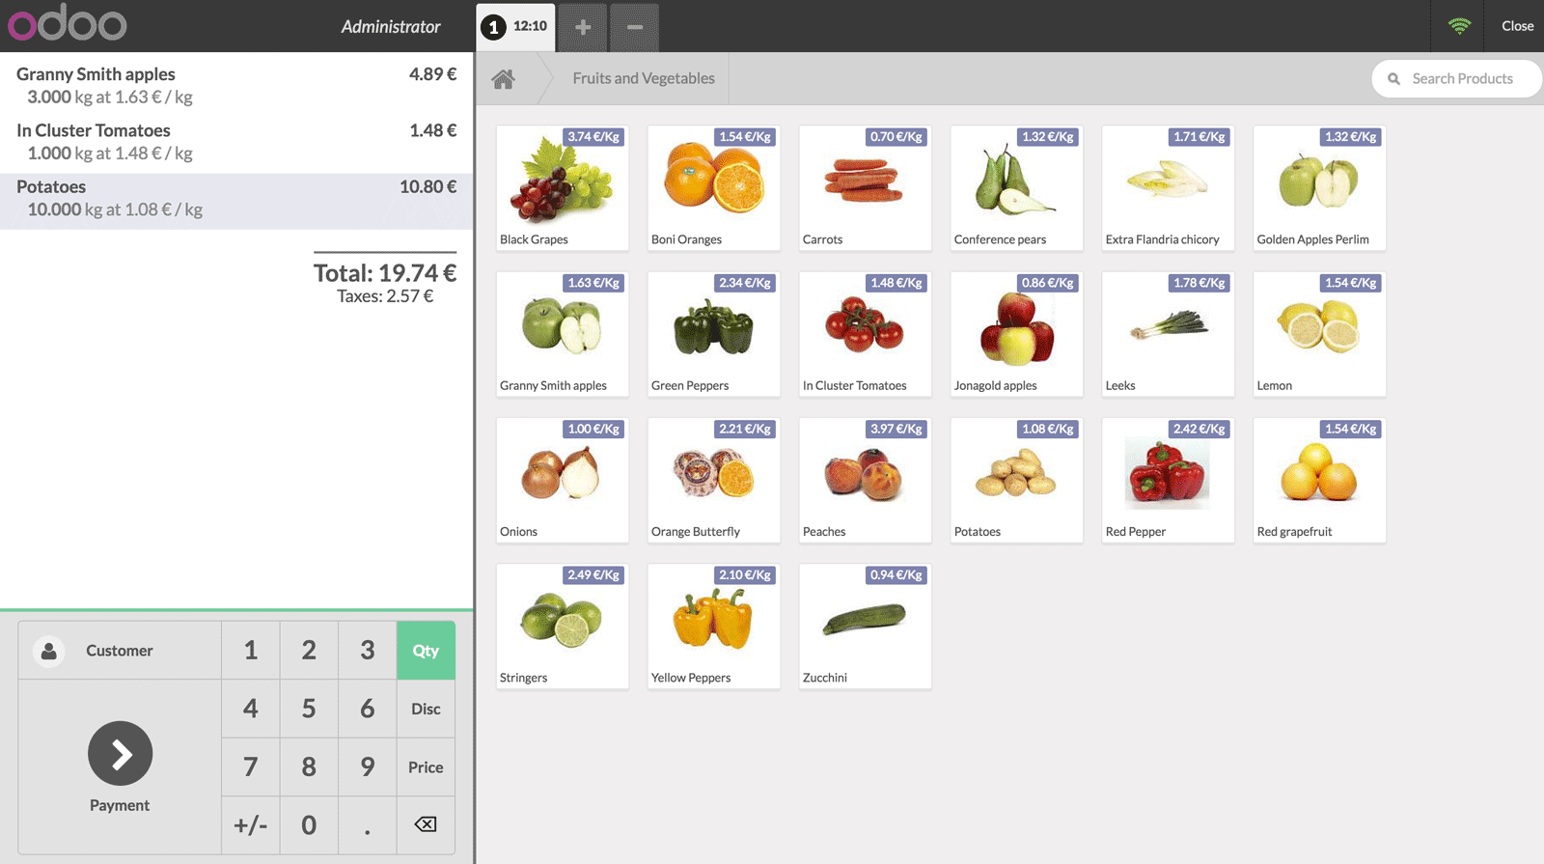

Slide 8
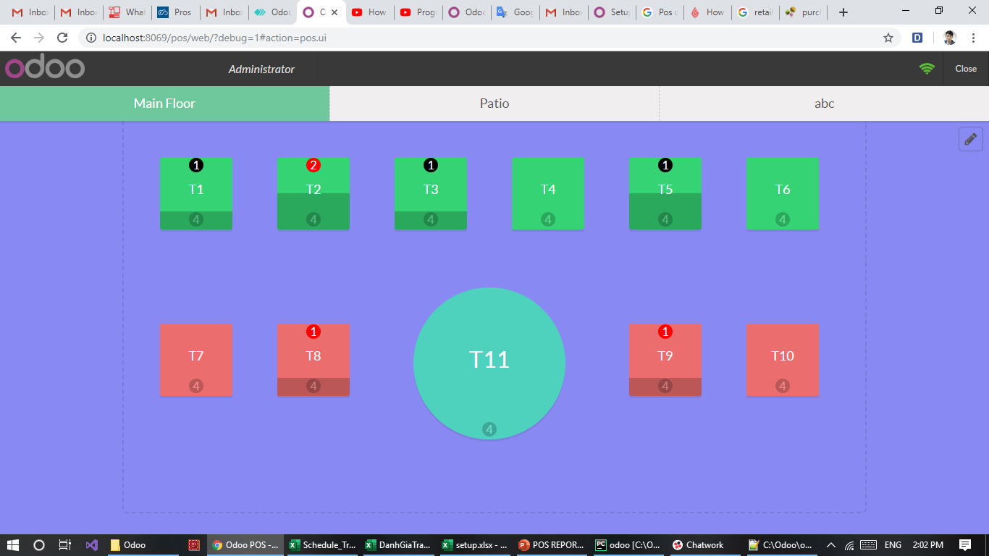

Slide 9
Function of Odoo Point of Sale
POS configuration
POS orders
POS reports
Inventory
POS

Slide 10
Function of Odoo Point of Sale
POS
SHOP
IOT
REST

Slide 11
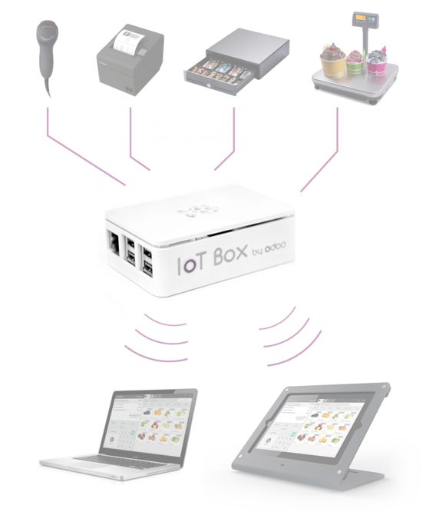
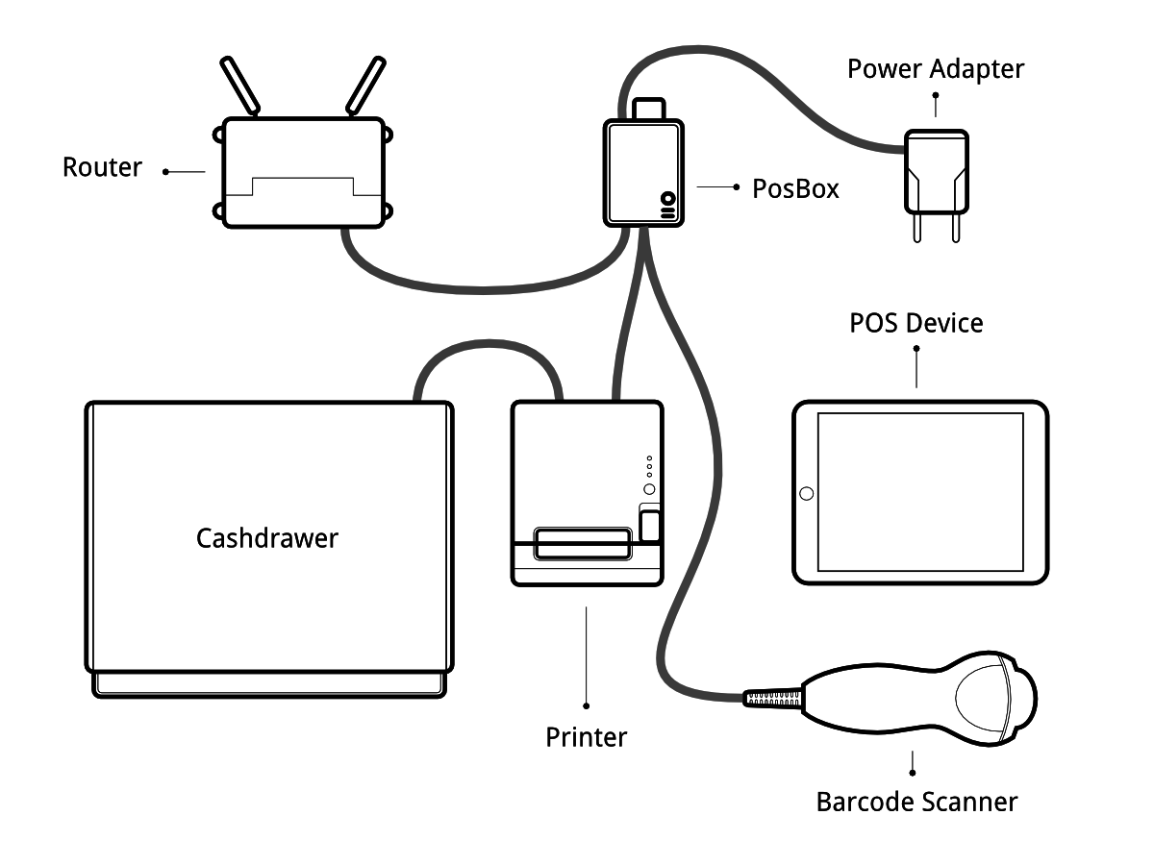
Function of Odoo Point of Sale
Odoo for IOT

Slide 12
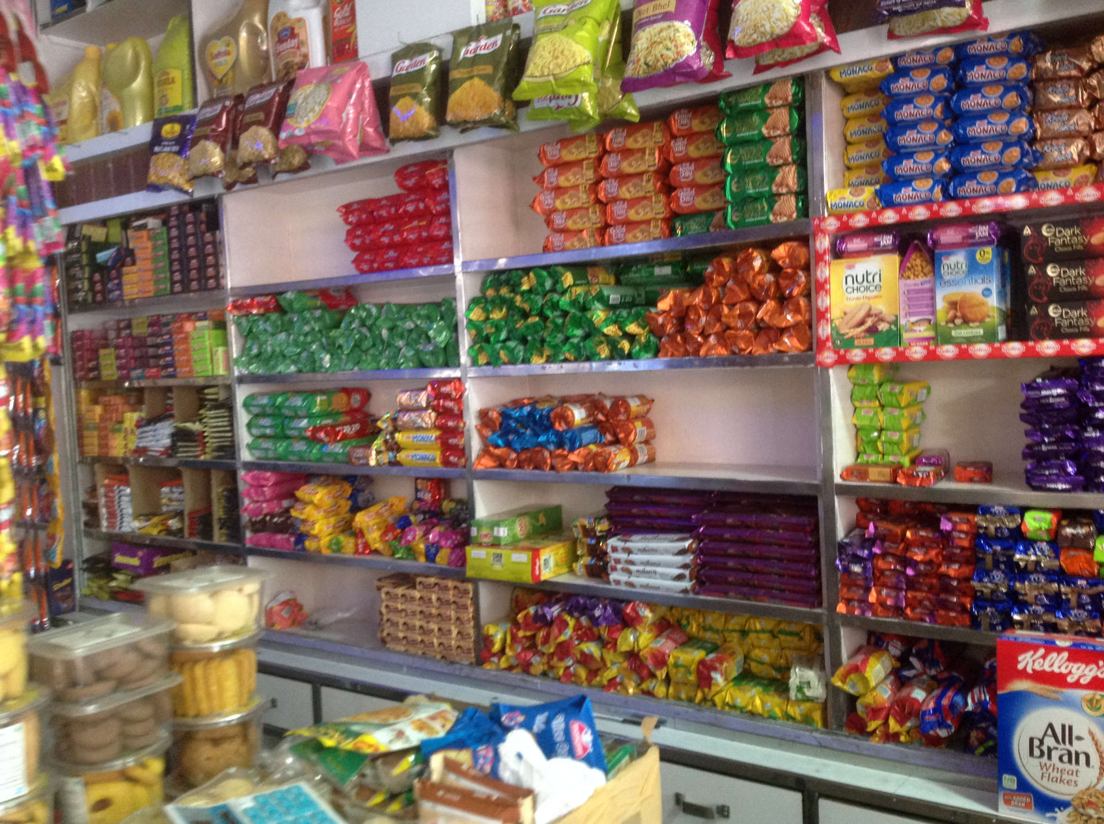
Function of Odoo Point of Sale
Odoo for Shop
Providing function for Retail Store
Inventory
Purchasing
Reporting
Multi-Store

Slide 13

Function of Odoo Point of Sale
Odoo for Restaurant
Food and drink businesses have very specific needs that the Odoo Point of Sale application can help you to fulfill.
Order Taking
Table Management
Accept payments table side
Inventory

Slide 14
Demo Point of Sale
1. Create a customer
2. Activate invoicing
3. Accept returns and refund products
4. Apply time-limited discounts
5. Set-up Cash Control in Point of Sale
6. Setup POS Restaurant/Bar
7. Configure your table management
8. Offer a bill-splitting option
9. Print the Bill
10. Print orders at the kitchen or bar
11. Integrate a tip option into payment
12. Transfer customers between tables
13. Register multiple orders
13. Using barcodes in POS
15. Using discount tags with a barcode scanner
16. Manage multiple cashiers
17. Manage a loyalty program
18. Apply manual discounts
19. Reprint Receipts
20. Accept credit card payment using Mercury

Slide 15
Summary
Advantages of Pos when developing by Odoo
Odoo handles a range of business needs
This tool seamlessly integrates all these operations to improve the overall efficiency.
This user-friendly platform always includes innovative applications
Navigation of Pos when developing by Odoo
Need customization for compatible with your store

Slide 16
ODOO FRAMEWORK TRAINING REPORT
THE END!
Thank you for listening !
Reporter: Phan Van Phuoc Thinh
Email: thinh.pvp@vn.vinx.asia

